Slide 1
MOLECULAR CYTOPATHOLOGY
NGS IN CYTOLOGY SPECIMENS
Fernando Schmitt
FMUP/RISE

Slide 2
Declaração de Conflito de Interesse
Prof. Fernando Schmitt afirma não ter conflito
de interesse a declarar
Exigência da RDC Nº 96/08 da ANVISA

Slide 3
NGS IN CYTOLOGY SPECIMENS
Learning objectives
Understand the importance of cytological samples in molecular analysis, particularly in the context of next-generation sequencing (NGS), for comprehensive genomic profiling.
Identify the various cytological preparations from which high-quality nucleic acids, including DNA and RNA, can be extracted, and comprehend their significance in ensuring reliable results in downstream molecular assays.
Recognize the pivotal role of cytological samples in the application of NGS across major types of solid tumors, and appreciate how their utilization contributes to advancing our understanding and treatment approaches in oncology, particularly in the identification of personalized therapeutic options.

Slide 4
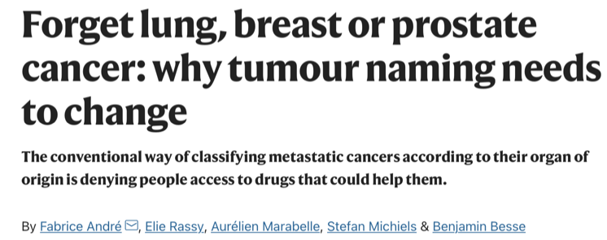
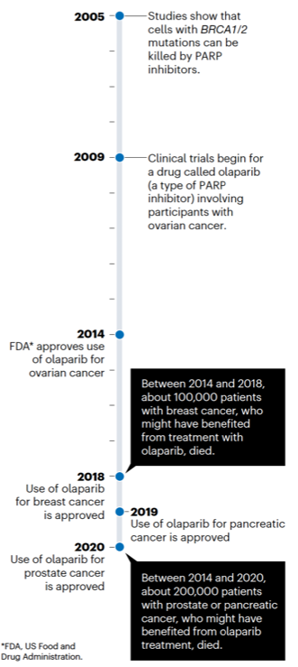
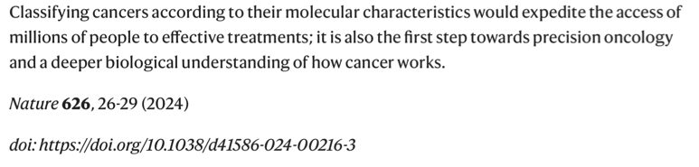

Slide 5
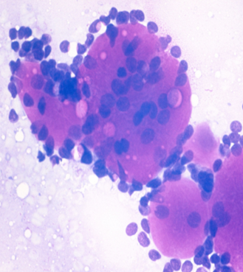
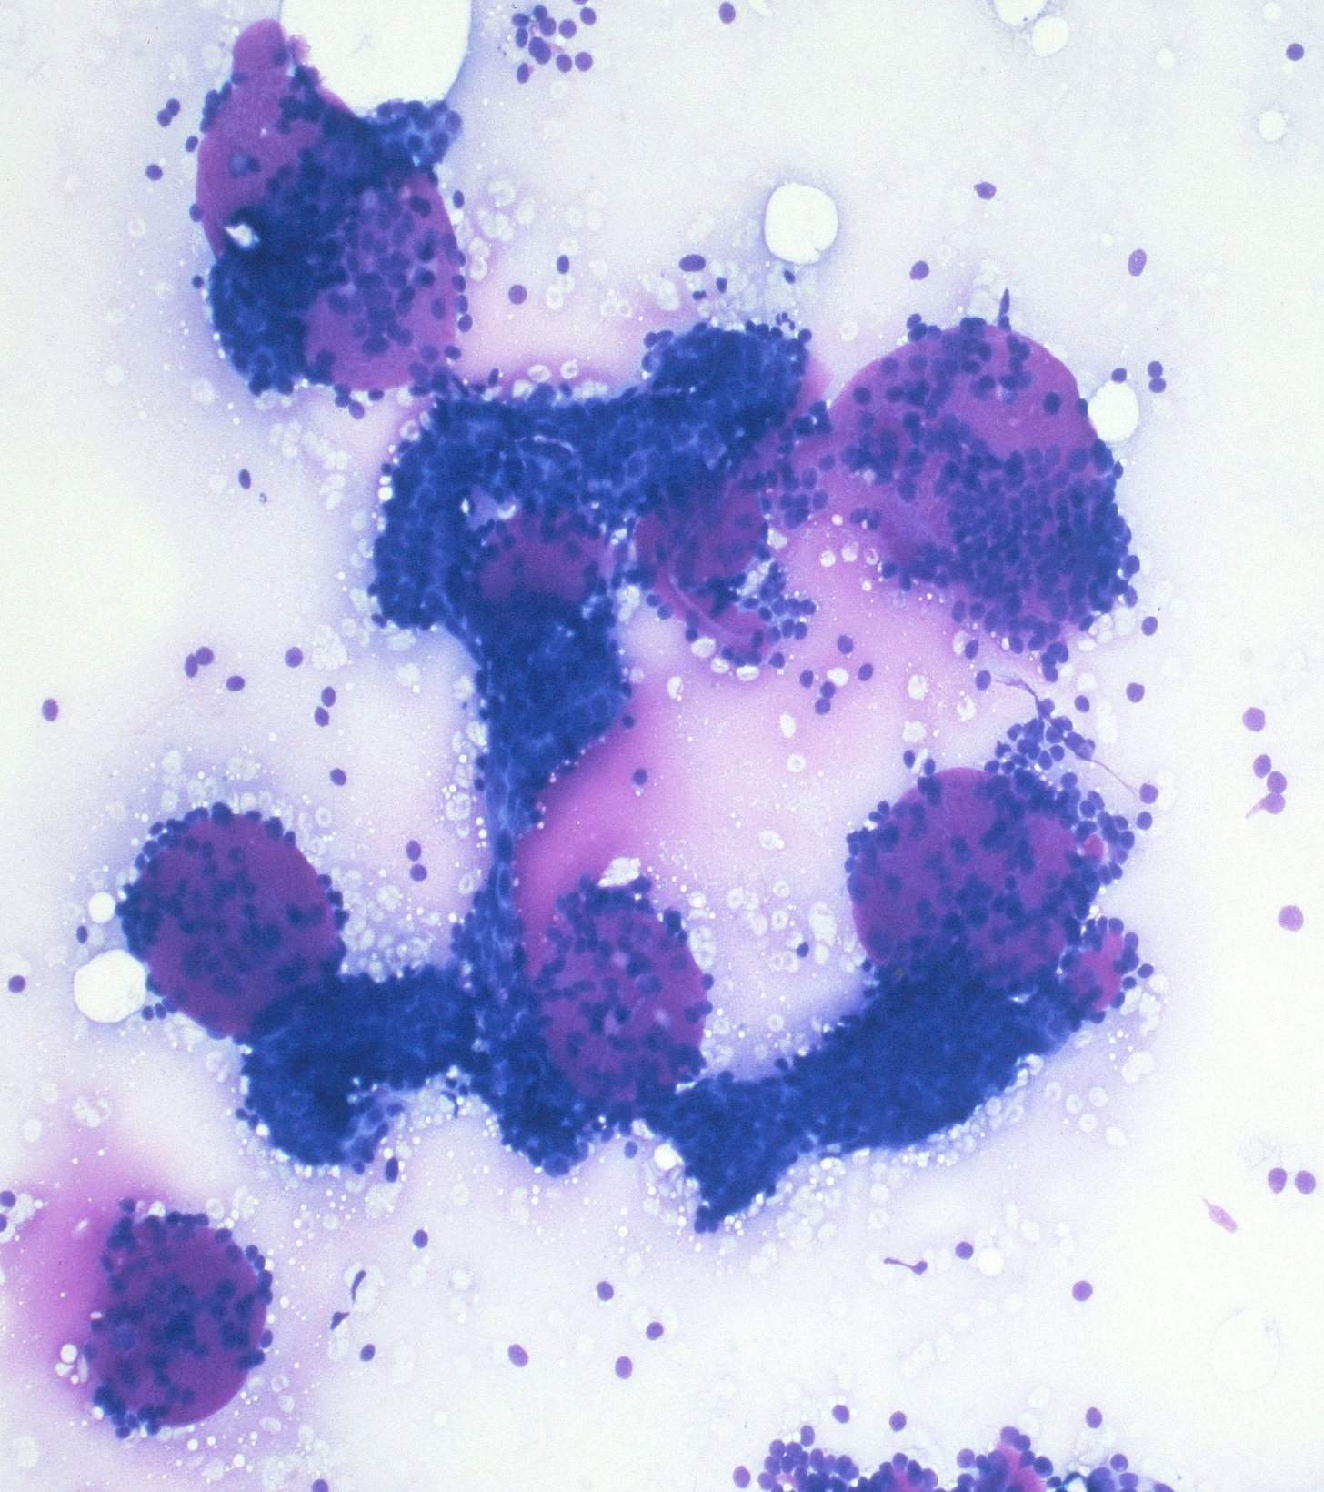
45-year-old woman with a palpable mass at right breast. No palpable lymph nodes.
FNA was performed.

Slide 6
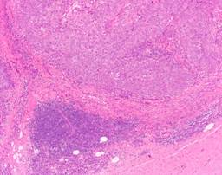
TRIPLE-NEGATIVE BREAST CANCER

Slide 7
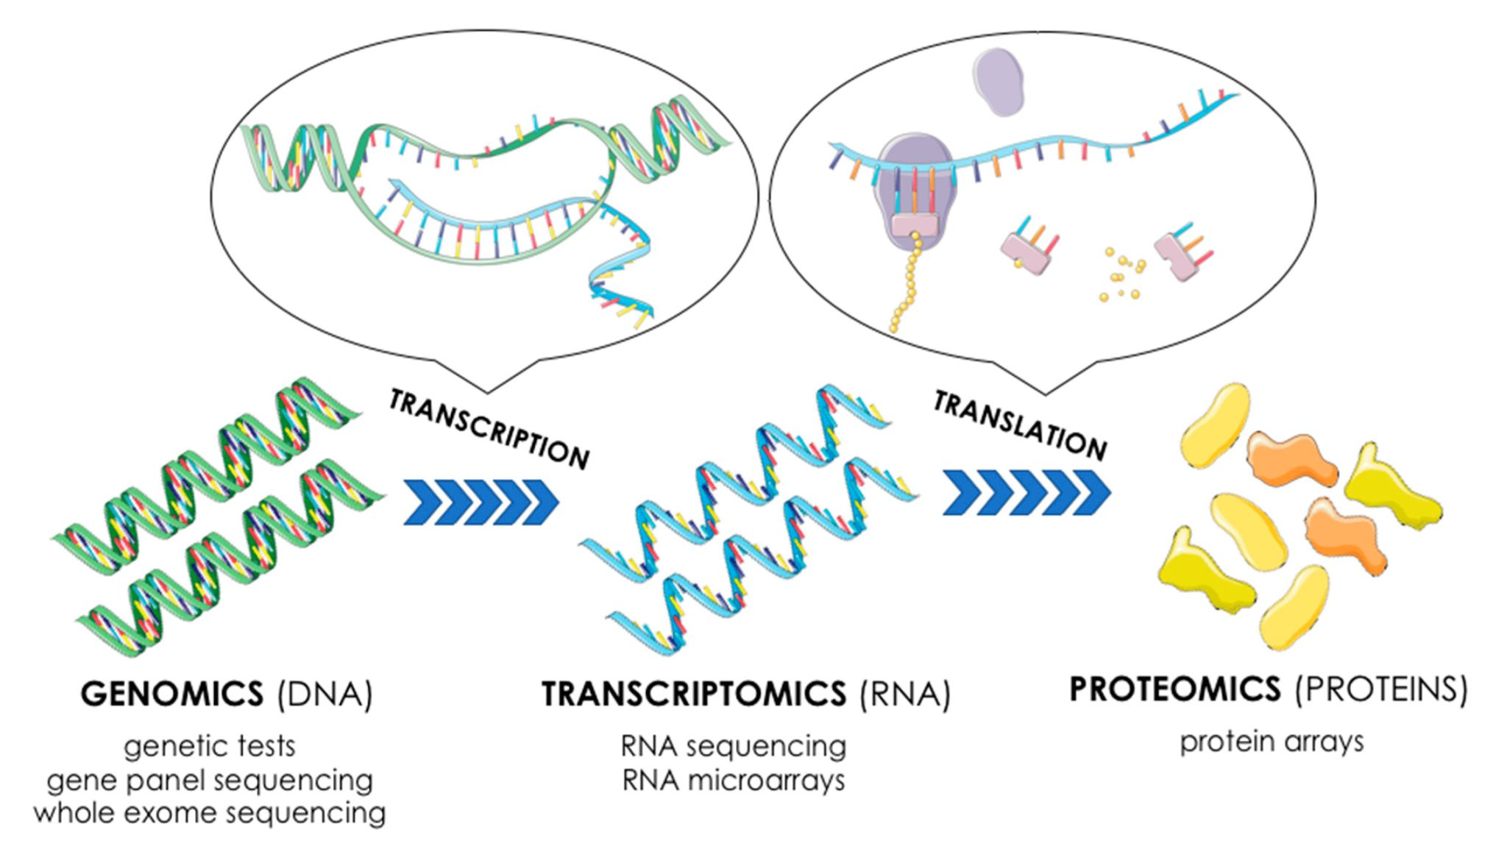

Slide 8
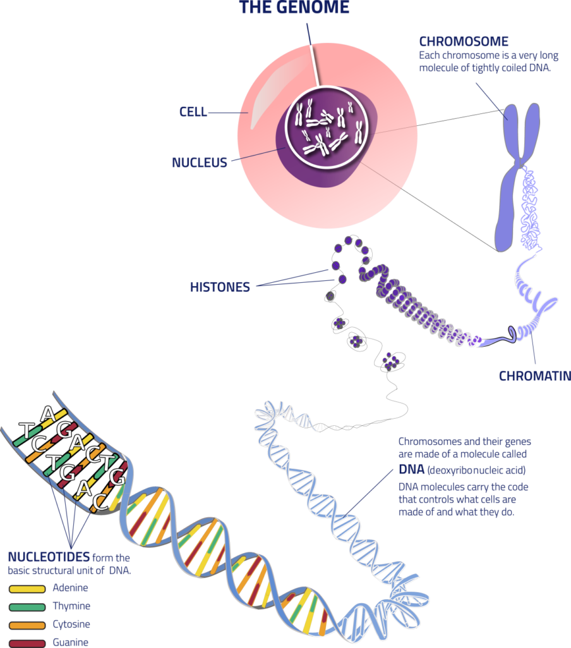
GENOMICS
Genomics is an area of ​​knowledge that studies the complete genome of an organism (coding and non-coding regions).
Genomics studies the structure, function, evolution, mapping and editing of genomes.

Slide 9
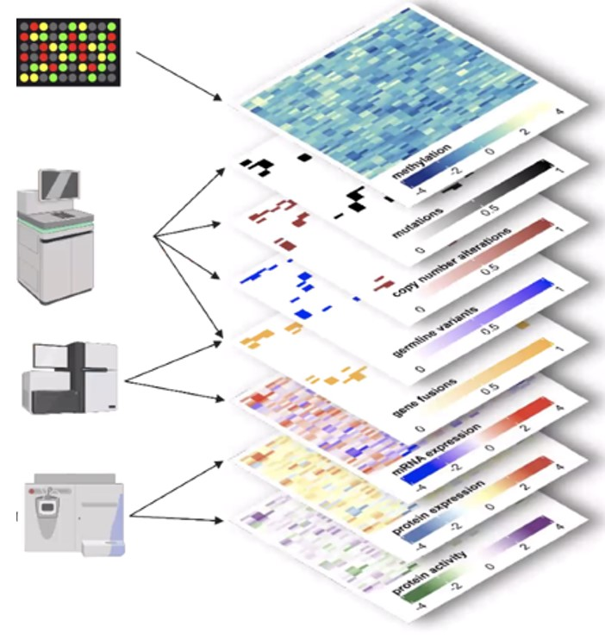
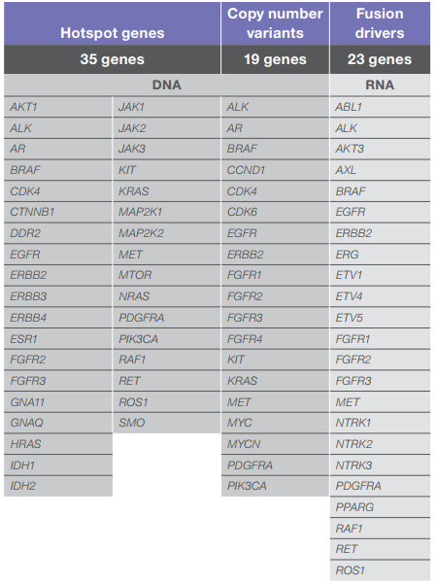
MOLECULAR TECHNIQUES
Sanger Sequencing
PCR ARMS Scorpions
High-resolution melting assay
(HRMA)
QIAGEN Therascreen
Digital Droplet PCR
NGS
  ThermoFisher
  Illumina
  Rochew Avenio
ABC, advanced breast cancer; AE, adverse event; AI, aromatase inhibitor; CDKi, cyclin-dependent kinase inhibitor; ET, endocrine therapy; HER2–, human epidermal growth factor receptor 2-negative; HR+, hormone receptor-positive; PFS, progression-free survival; PIK3CA, phosphatidylinositol-4,5-bisphosphate 3-kinase catalytic subunit alpha.
1. Juric D, et al. SABCS 2018. Abstract GS3-08 (oral); 2. André F, et al. N Engl J Med. 2019;380(20):1929-1940.

Slide 10
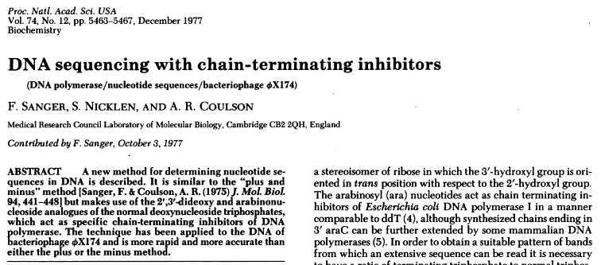
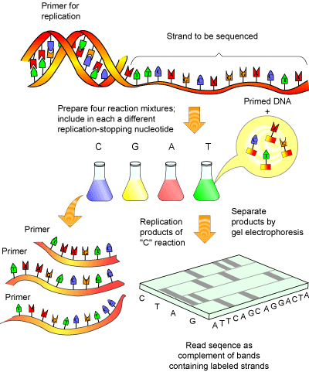
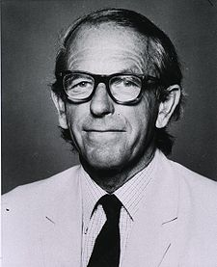
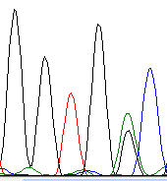
KRAS G13D
Sanger sequencing

Slide 11
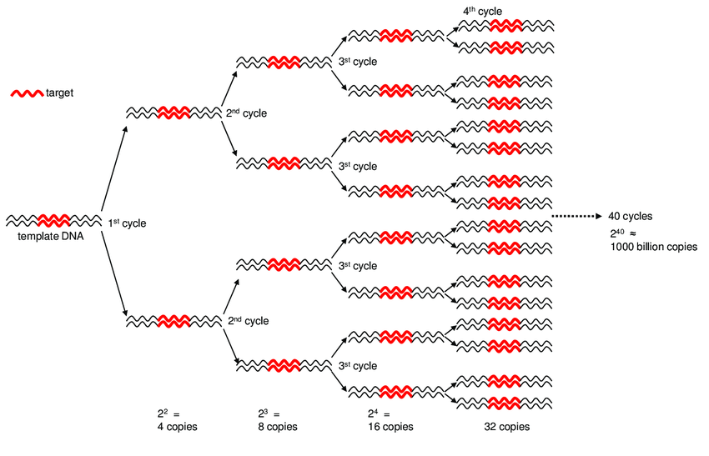
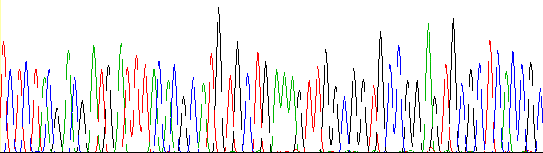

Studying genes for mutations: Sanger sequencing
Forward Primer
1. Primer design
Reverse Primer
2. PCR
3. Sanger Sequencing (based on terminator di-deoxy nucleotides)
M B C1 C2 B C1 C2
4. Mutation detection
Generate sequence
….TCTCTACGACGATGATTTACACGCATGTGCTGTAAGTTGGCGGTGCCGGAGTGCGCTCACCGC…
Compare to reference genome
….TCTCTACGACGATGATTTACACGCATGTGCTGAAAGTTGGCGGTGCCGGAGTGCGCTCACCGC…
….TCTCTACGACGATGATTTACACGCATGTGCTGTAAGTTGGCGGTGCCGGAGTGCGCTCACCGC…
Lysine → Stop!

Slide 12
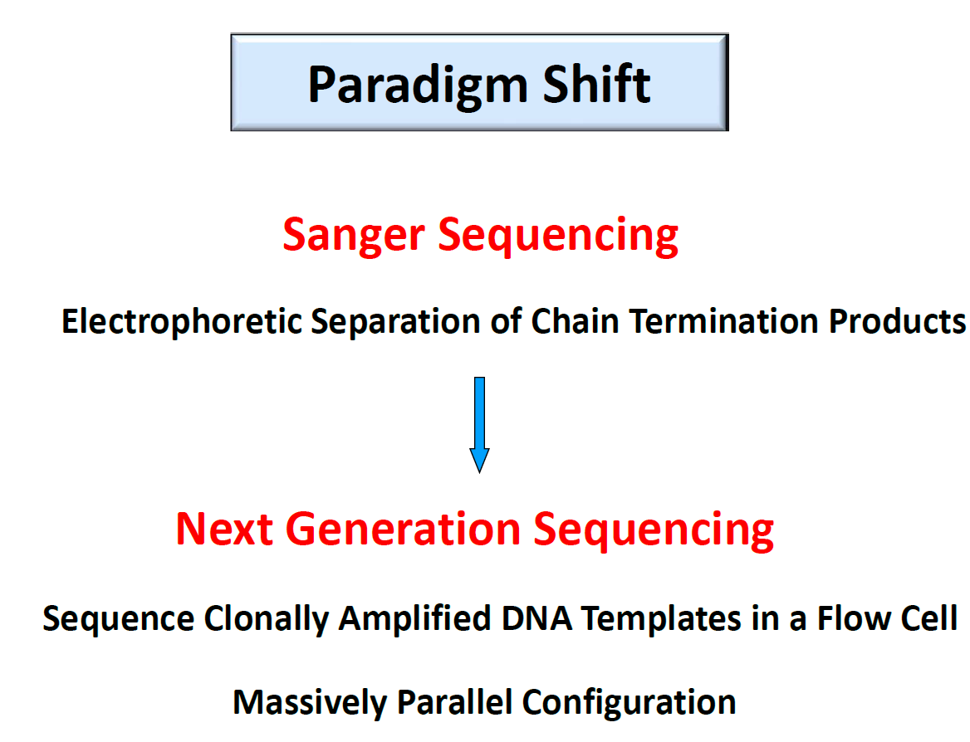
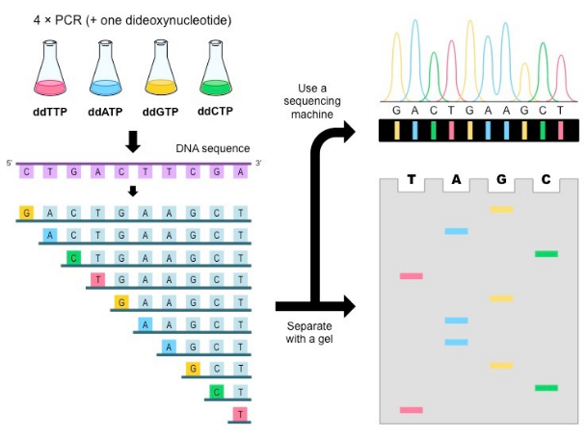
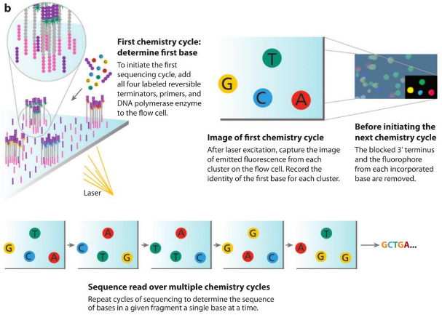
NGS – a technological revolution
1977
2005

Slide 13
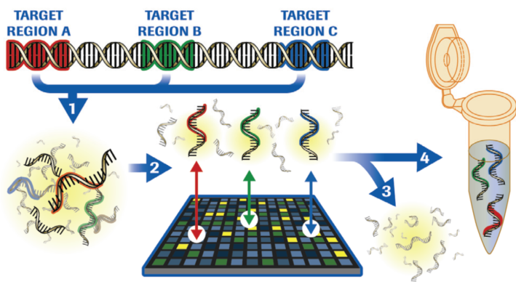
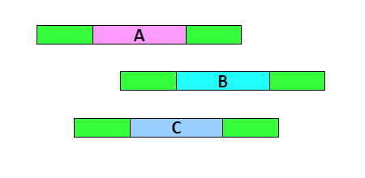
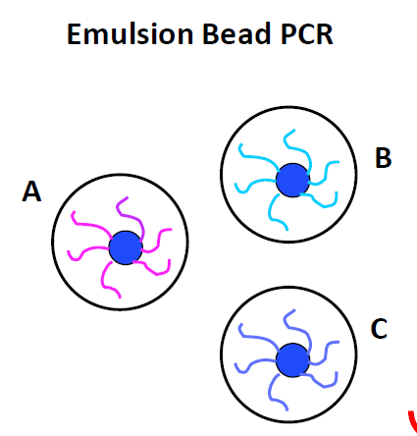
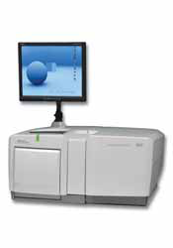
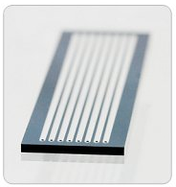
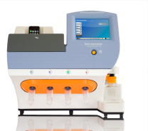
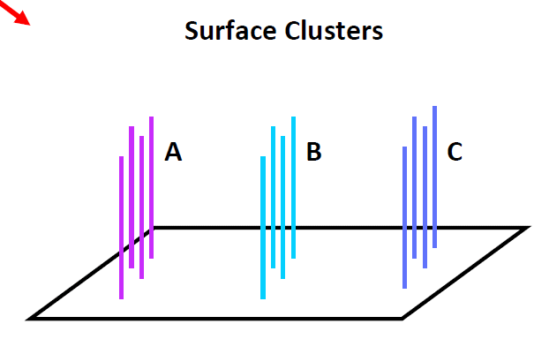

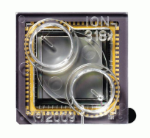
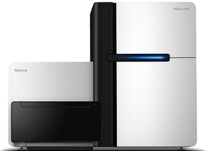
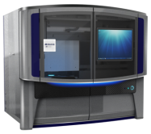
Next generation sequencing sample prep workflow
DNA fragmentation
Enrichment
Repair and adaptor ligation
Clonal amplification
Deposition in sequencing support
Sequencing

Slide 14
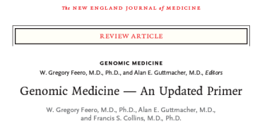
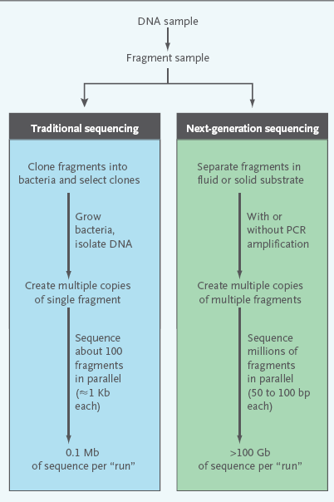
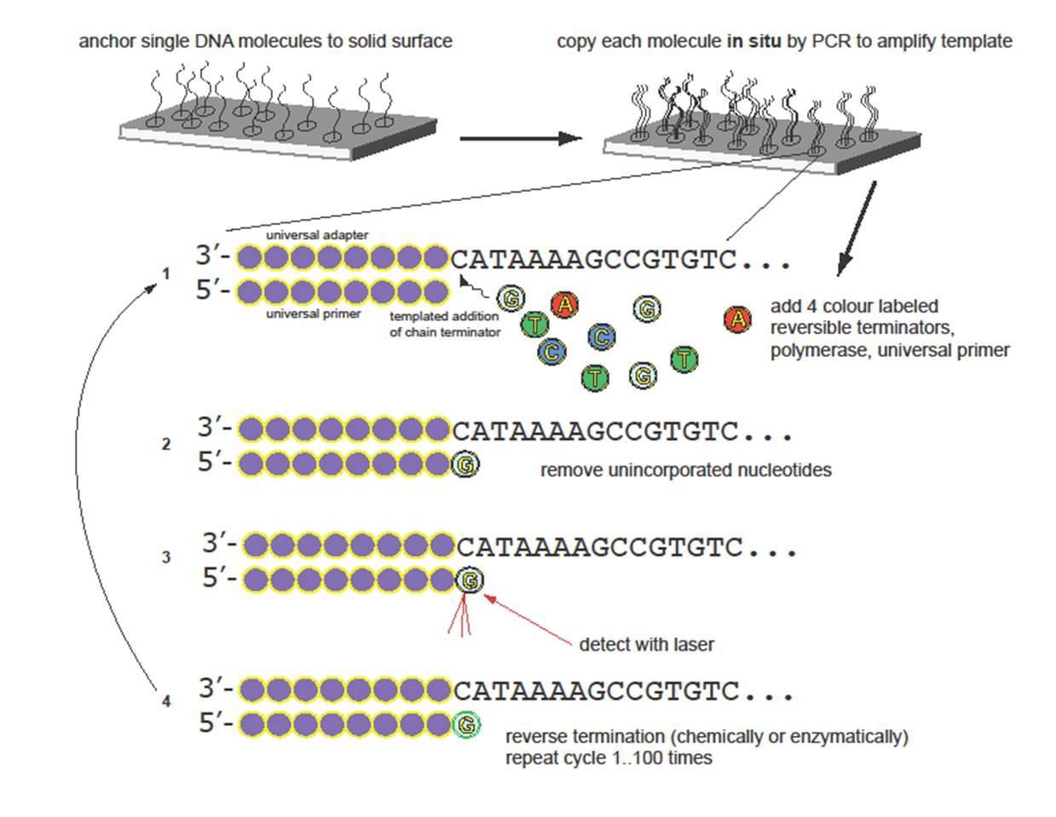

Slide 15
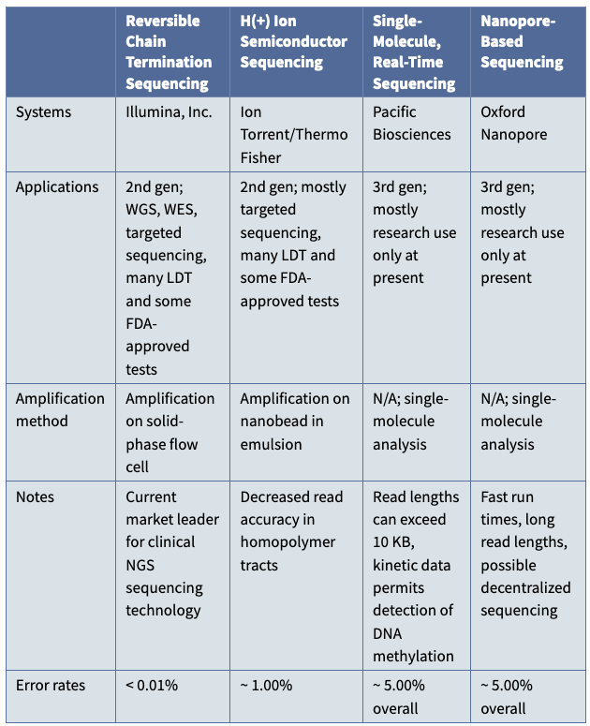


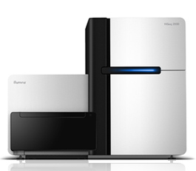
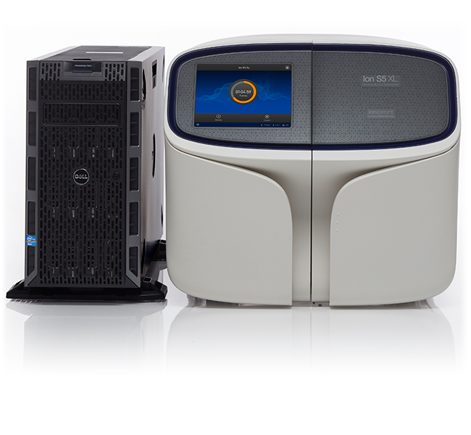



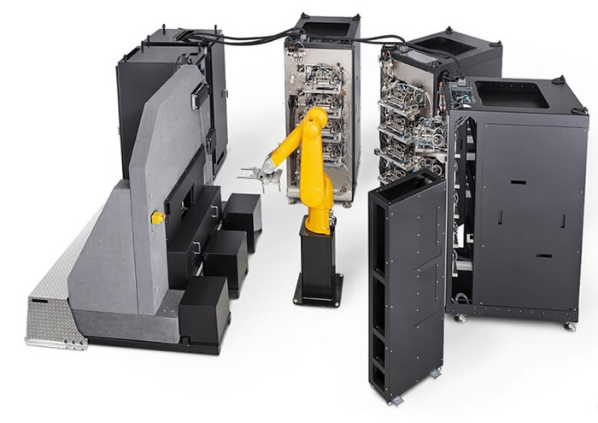

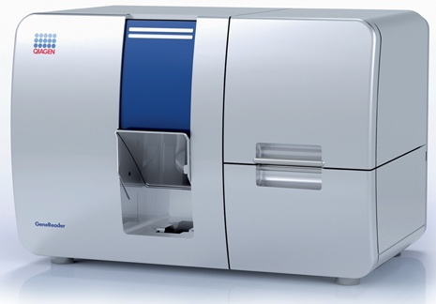
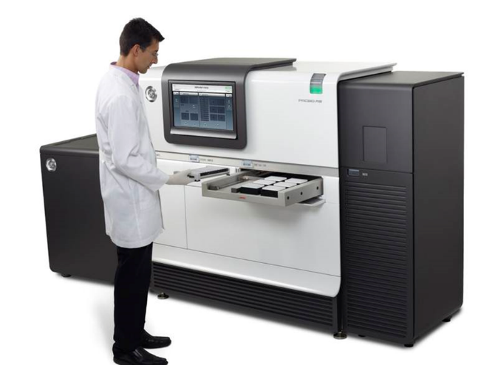
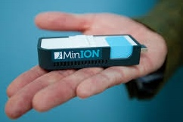

NGS – a technological revolution

Slide 16
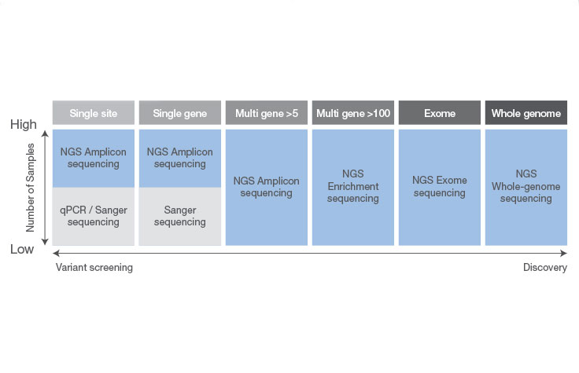
Sanger vs NGS
1 disease
1 (single) mutation
1 disease
many genes
1 disease
few genes
1 disease
1 gene
different diseases
few genes
different diseases
many genes
different diseases
1 (single) gene
Sanger sequencing
Next-Gen sequencing

Slide 17
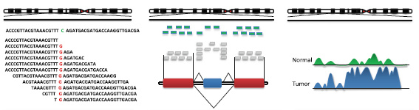
Next generation sequencing applications
Genomic sequencing
Transcriptome
Small RNA
ChIP-seq Methylation
SNVs, Indels, mutations
Translocations, CNVs, SVs
Gene expression, novel transcripts, fusion genes, splice variants
DNA methylation, TF binding regions

Slide 18
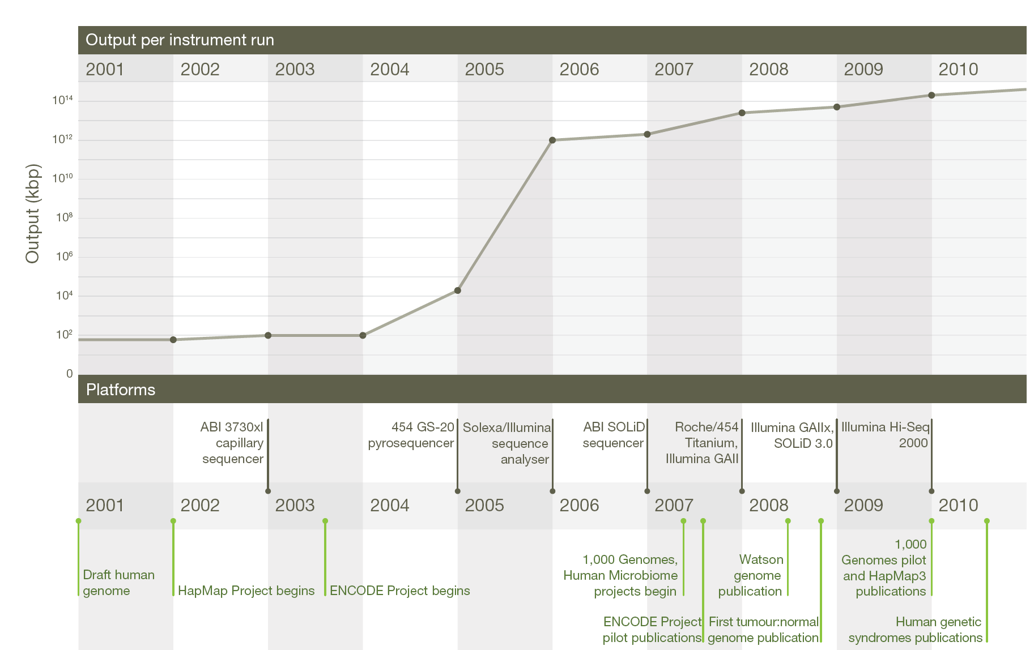
Sequencing output increases dramatically
E Mardis. Nature 2011

Slide 19
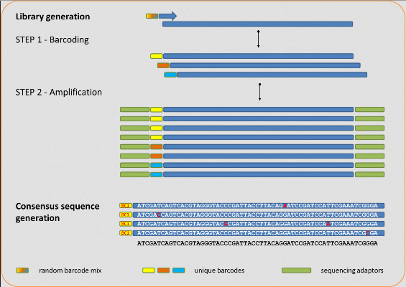

Which technology should be used for mutation testing?
Any validated.
However, multiplexed genetic testing with NGS is strongly recommended over single-gene testing.
Cheaper
Quicker
Sample-friendly
Sensitive

Slide 20
What type of sample can be used at the diagnosis stage?
Surgical specimens
Tissue biopsies
Cytology specimens, with adequate cellularity.
Plasma samples (liquid biopsies), if other sample is not available or if re-biopsy is not feasible.

Slide 21
Molecular Pathology Lab U.Porto
NGS and Foundation One data for Oncology

Slide 22
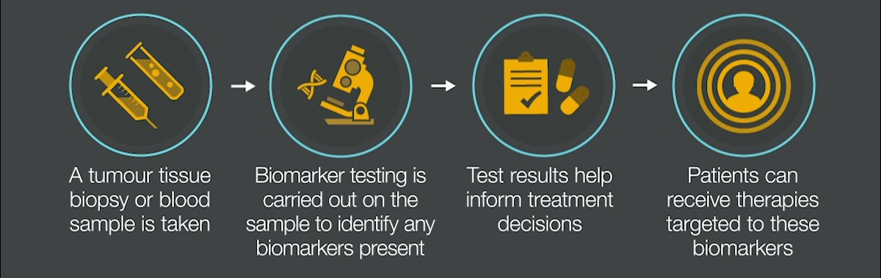
Precision Medicine and Biomarkers
Adaptado de: https://twitter.com/astrazeneca/status/1043843954842558464

Slide 23
MUTATION STATUS TESTING WORKFLOW
Molecular genetics lab
Diagnosis
of
Cancer
Sample
Selection
Mutation
Screening
Molecular
report
Oncologist
Pathologist
Registration
Morphology
Control
DNA
Extraction
DNA
Analysis
Molecular
Pathology
report

Slide 24
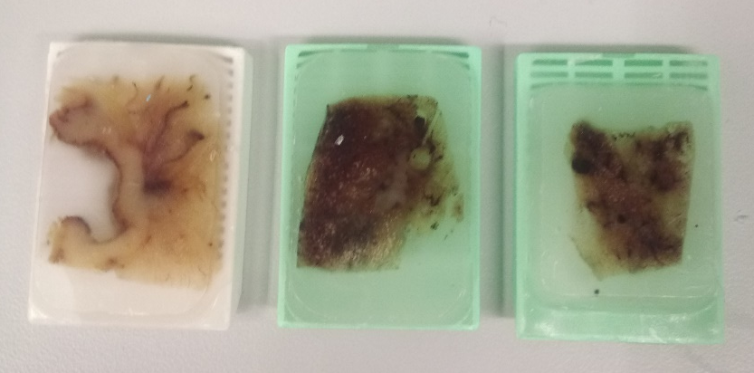
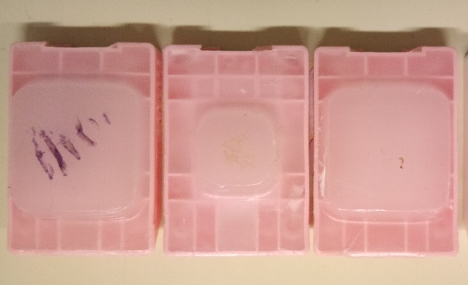
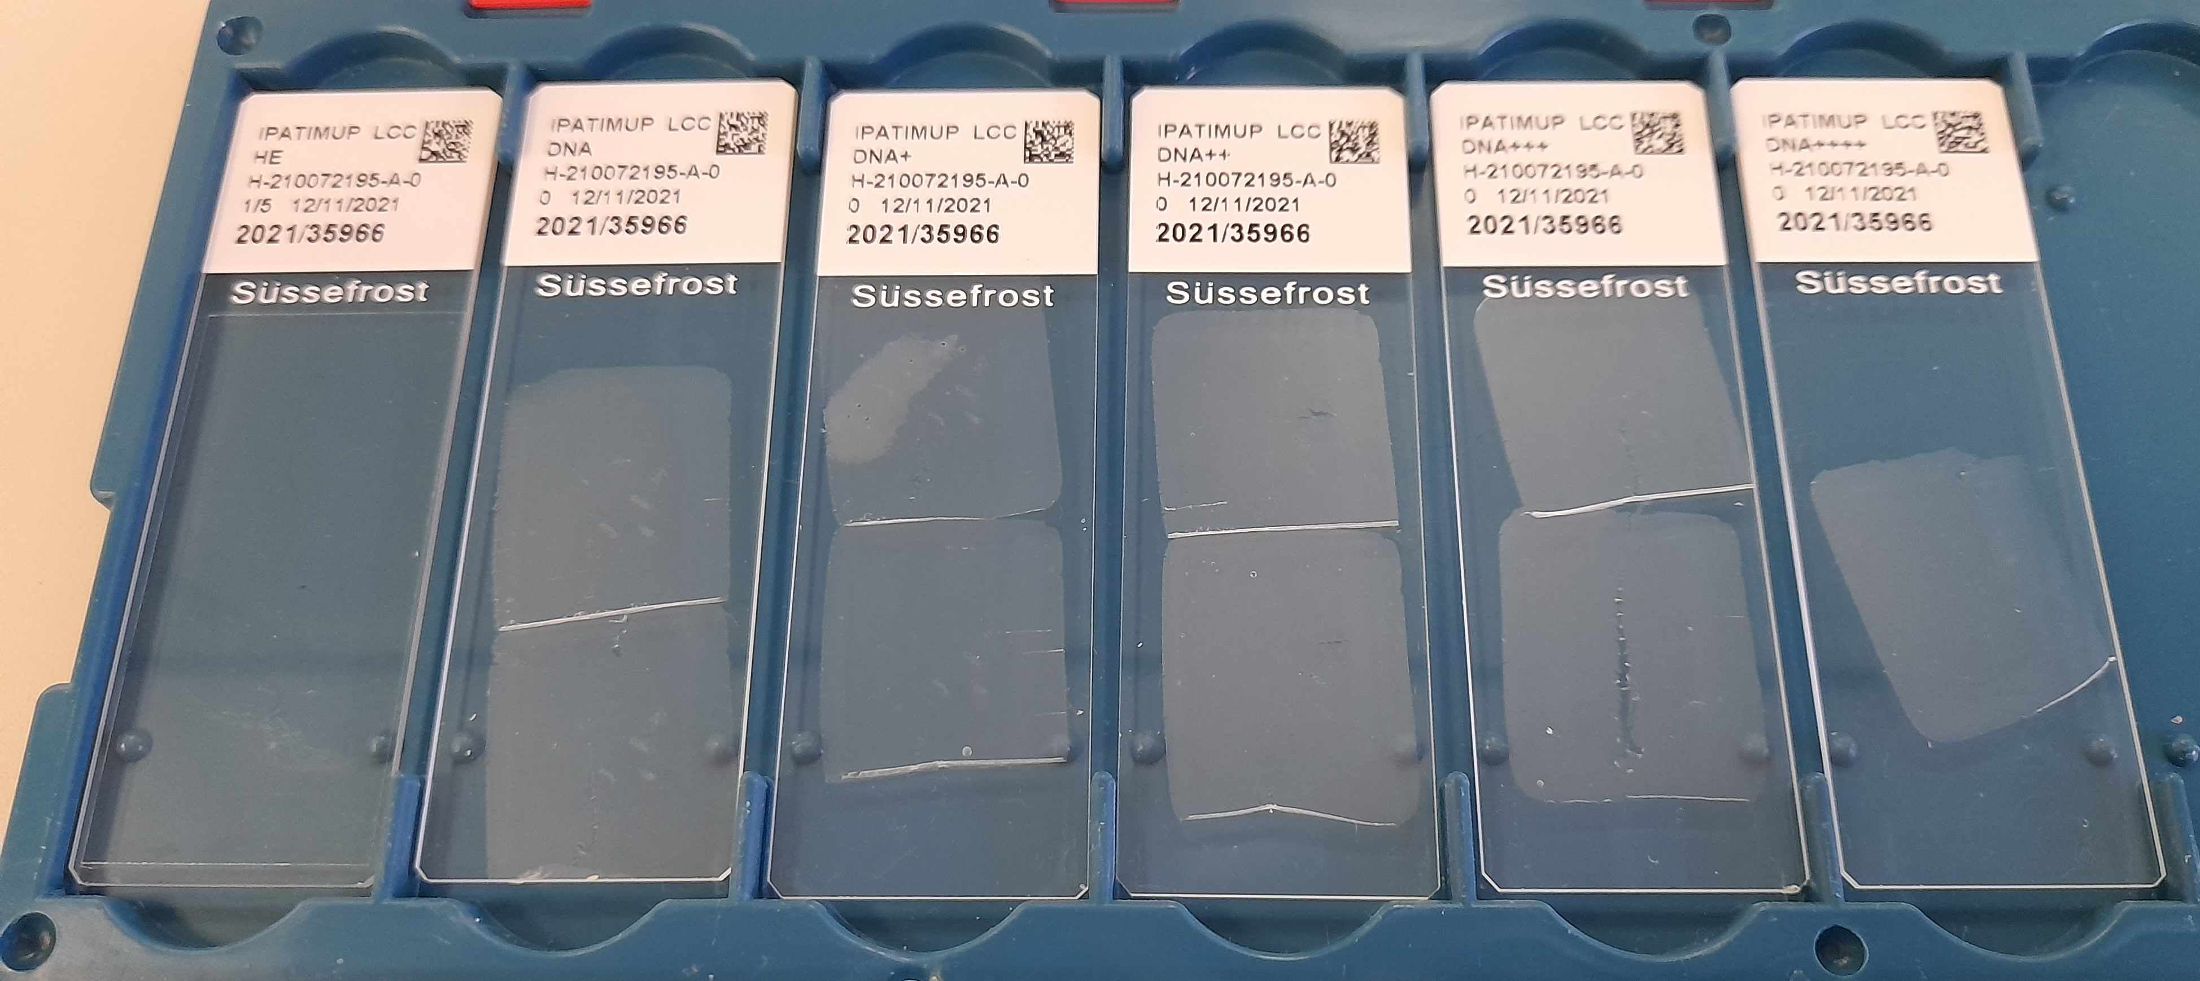
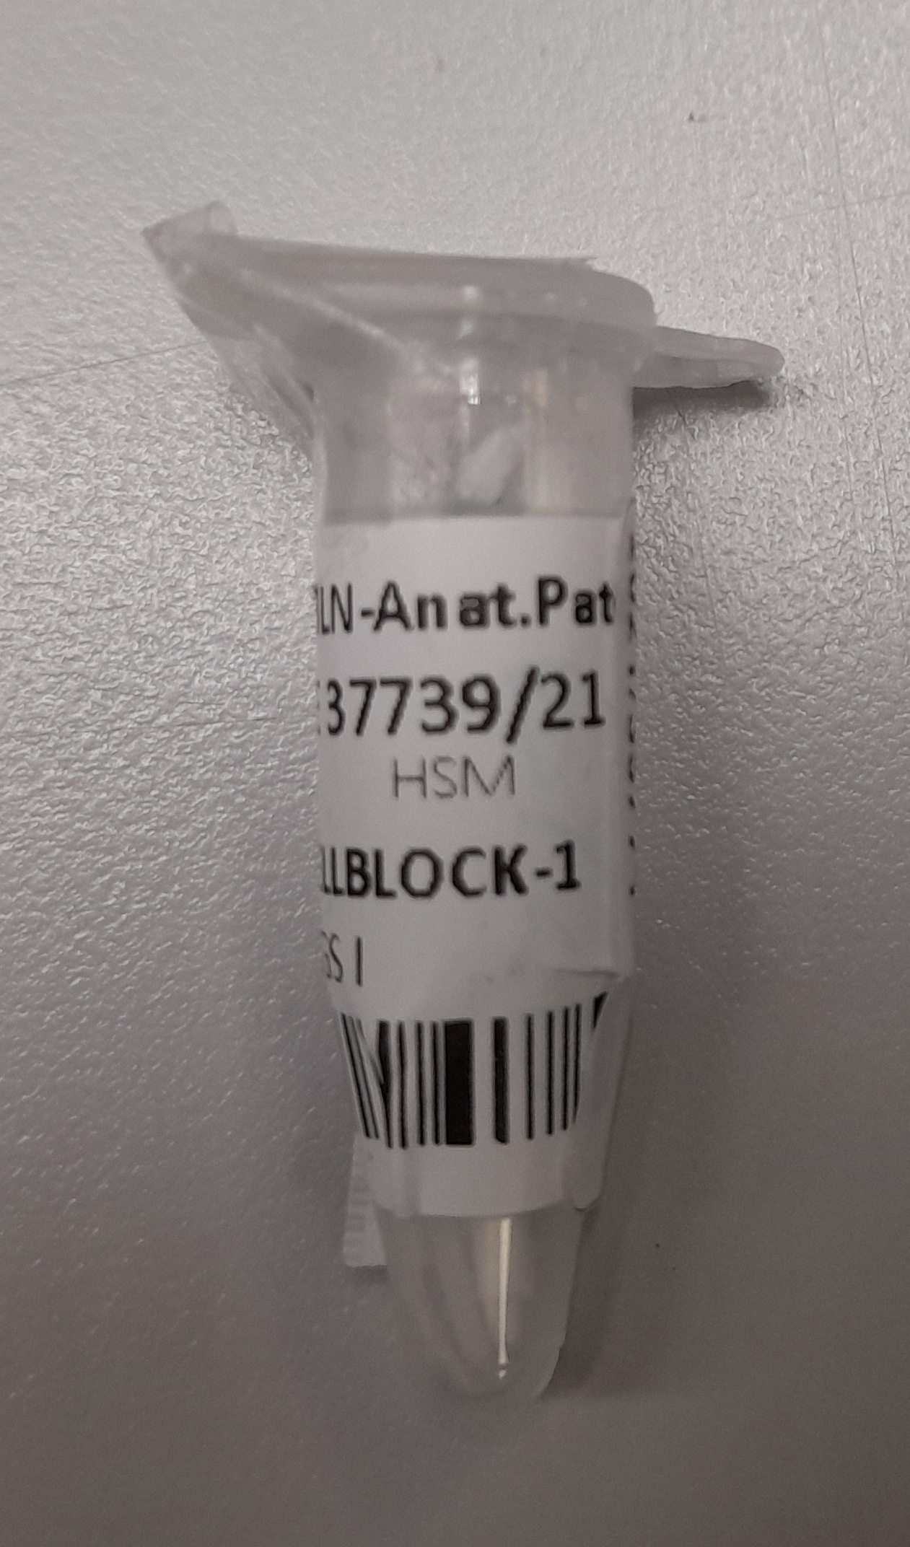
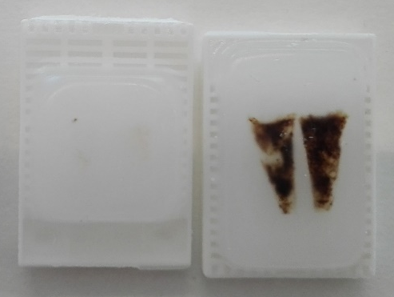
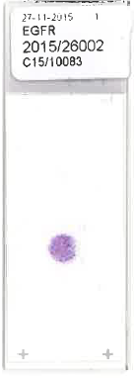



Samples
X
X
X
X

Slide 25
MOLECULAR CYTOPATHOLOGY
Most of the advances in predictive biomarkers have initially been based on studies and clinical trials that relied on histological specimens.
Accordingly, technical protocols and algorithms for evaluation or scoring had often been established for histological specimens, which raised the false impression that cytological specimens are not suitable for molecular testing by nature.
This misconception among pathologists and clinicians was most prevalent in the early days of predictive marker testing and was reinforced by the popular but imprecise term “tissue is the issue”.

Slide 26

2015

Slide 27
MOLECULAR CYTOPATHOLOGY
Given the reality that a variably large fraction of cancers are diagnosed by cytology alone, this narrow, tissue-centered view has not survived for long.
Enough evidence has been accumulated showing that cytological preparations are equivalent to histological specimens for diagnostic and predictive molecular testing.
The reputation of cytology has taken a flying leap due to its now-recognized importance in predictive marker testing, not only among pathologists but also among clinicians (guidelines for molecular testing in lung cancer)

Slide 28
MOLECULAR TESTING HAS BROUGHT CYTOLOGY INTO PRIME TIME

Slide 29


MOLECULAR CYTOPATHOLOGY

Slide 30
MOLECULAR CYTOPATHOLOGY
Historical Perspective
DIAGN CYTOPATHOL 27: 210-213, 2002
DIAGN CYTOPATHOL 19: 395-397, 1998

Slide 31

Massive parallel sequencing worflow

Slide 32


CYTOLOGY SAMPLES
Advantages
FNAB
Rapid
Minimally invasive
Inexpensive
VARIETY OF CYTOLOGICAL PREPARATIONS
Smears
Cellblocks
LBC
Cytospins

Slide 33
CYTOLOGY SAMPLES
MOLECULAR ADVANTAGES
    Cytological samples represent a valid source of high-quality DNA/RNA for molecular analysis.
    Cytological samples provide a higher quality of nucleic acids with higher purity, higher cellular yield, and better tumor fraction for molecular testing.

Slide 34





Slide 36




Cancer Cytopathology 2019
Molecular Cytopathology Group
Genomic reference standards representative of routine cytology clinical practice showed highly reproducible results across all laboratories in detection of mutations down to 5% of AF despite the difference in smears staining and sequencing practices.

Slide 37






Slide 38
MOLECULAR CYTOPATHOLOGY
Today, there is no question whether or not molecular testing can be done on cytology.
Cytology contains the same cells, the same RNA, DNA, and protein molecules as corresponding histology.
However, cytological specimens have no tissue context, usually lack a stromal component, and are processed differently, which may require different approaches and modified protocols for molecular analysis.

Slide 39
Pre-analytical factors that affect NGS analysis in cytology
Specimen cellularity.
Type of preparation.
Type of fixative and stains.
Type of glass slides.
Tumour fraction.
DNA yield
Input DNA
Chen H. et al. Cancer 2015

Slide 40
We need to actively participate in the process of Specimen Acquisition
Good communication with clinicians, lab technicians, cytotechs, nurses…
Providing a clear order form
Using image-guided procedure for better yield
Optimizing technique for best diagnostic yield (FNA sampling technique, needle size, number of passes…)
ROSE

Slide 41

Go where the fresh material is…

Slide 42

WORKFLOW OF ROSE
Is the specimen representing the target?
Clinical features/ radiology
Is the amount and quality of cells sufficient for a satisfactory morphologic evaluation?
  What is the preliminary diagnosis?
Any ancillary test needed either for diagnosis or for therapy?
  How should I handle the specimen?
Jain D, et al. Arch Pathol Lab Med 2018;142:253-62.

Slide 43
Any kind of cytological material can be used for molecular tests

Slide 45
MUTATION STATUS TESTING WORKFLOW
Molecular genetics lab
Diagnosis
of
Cancer
Sample
Selection
Mutation
Screening
Molecular
report
Oncologist
Pathologist
Registration
Morphological
Control
DNA
Extraction
DNA
Analysis
Molecular
Pathology
report

Slide 46
Mutation frequency and morphological control
 | Mut | Wild-type | Total
Without control | 463 (38%) | 763 (62%) | 1226
With control | 309 (43%) | 408 (57%) | 717
P<0,05
 | Mut | Wild-type | Total
<20% tumour cells | 7 (26%) | 20 (74%) | 27 (4%)
>20% tumour cells | 296 (44%) | 378 (56%) | 674 (96%)
P<0,05

Slide 47

A philosophical change: replacing the primacy of “morphological diagnosis” by ”therapeutic decision”
Small biopsy and cytology samples should be managed not only for diagnosis but also to maximize the amount of tissue available for molecular studies.

Slide 48




If it is possible to choose
AIM
Samples with the highest amount of material
Avoid tissue sample with scarce material: history of larger immune staining and/or molecular test
Molecular analysis on the most Recent Sample
PATHOLOGY LABORATORY
MOLECULAR PATHOLOGY LABORATORY

Slide 49
Morphological control for molecular testing
Fraction of malignant cells greater than 10%–20% is considered a lower acceptable limit for molecular methods.
In cytology material samples with <100 cells are not suitable for NGS; 100–2000 low levels; 2000-5000 intermediary levels; >5000 cells are suitable for any NGS, including large panels.
The coverslip is removed using xylene if crystal coverslip is used or acetone if plastic and the selected cells on the slide are transferred into a buffer medium for nucleic acid extraction without need of destaining the slides.
Single Slide: Scanning and digital archiving is mandatory to ensure medical-legal issues

Slide 50


The matter is not histology vs cytology but the quality and quantity of tumour (target) cells

Slide 51
CYTOPATHOLOGIST ROLE IN MOLECULAR TESTING
Review Diagnostic Report
Choose best quality material:
ROSE or archived
Assess cellularity and purity
Quality/quantity sufficient
Quality/quantity insufficient
Process specimen
Cancel request
Molecular testing in-house
Enrich for tumour content according to analytic sensitivities
Outside molecular pathology laboratory
Integrate the molecular data in the original diagnostic report
Compare mutation signals with the extent of tumour cells in tested specimen

Slide 52
MUTATION STATUS TESTING WORKFLOW
Molecular genetics lab
Diagnosis
of
mNSCLC
Sample
Selection
Mutation
Screening
Molecular
report
Oncologist
Pathologist
Registration
Morphology
Control
DNA
Extraction
DNA
Analysis
Molecular
Pathology
report

Slide 53
Lung adenocarcinoma
The tumor cell content of this tumor was estimated to be 30% to 40%

Slide 54

Molecular Pathology Report

Slide 57



Slide 58



Slide 59





Lung cancer biomarker and therapeutic history
Testing strategy
Single gene approach
Multi-gene approach
Complex biomarker approach
Biomarkers
Chemotherapy
Immunotherapy
Targeted therapy
Chemotherapy
Immunotherapy
Targeted therapy
Future
?
Clinical impact
Politi K et al. Clin Cancer Res 2015 (doi:10.1158/1078-0432.CCR-14-2748); Herbst RS et al. Nature 2018 (doi:10.1038/nature25183); Planchard D et al.
Ann Oncol 2018 (doi:10.1093/annonc/mdy275); Tan WL et al. Lancet Oncol 2016 (doi:10.1016/S1470-2045(16)30123-1); Maus MV et al. Annu Rev Immunol
2014 (doi:10.1146/annurev-immunol-032713-120136); Skoulidis F et al. N Engl J Med 2021 (doi:10.1056/NEJMoa2103695); Park K et al. J Clin Oncol 2021 (doi:10.1200/JCO.21.00662); Le X et al. J Clin Oncol 2022 (doi:10.1200/JCO.21.01323); Thai AA et al. Lancet 2021 (doi:10.1016/S0140-6736(21)00312-3)
TMB = tumor mutation burden

Slide 60









Approach to lung small biopsies and cytologic samples
Barroca H & Schmitt f, Cancer Cytopathol 2011
Subtyping is needed!
But saving the tissue is even more important
CRG
P40
TTF1
TTF1
P40
SMALL CELL CARCINOMA
ADENOCARCINOMA
SQUAMOUS CELL CARCINOMA

Slide 61


LUNG

Slide 62
NGS

Slide 63
REFLEX TEST
Lazzari, Chiara, et al. "Next generation sequencing in non-small cell lung cancer: pitfalls and opportunities." Diagnostics 10.12 (2020): 1092

Slide 64
Cytology Can Provides a Reflex Testing Option
Dr. Ricella Silva
MD, PhD |Pathologist

Slide 65

PANCREAS

Slide 66




PANCREAS

Slide 68



THYROID

Slide 69
METASTATIC CANCER
FNA, when associated with ancillary techniques, is a reliable method for sampling and tracking metastatic evolution.

Slide 70

METASTATIC DISEASE? AND NOW? Be sure to treat the present disease
Primary BC
HER-2 negative
Metastases BC
HER-2 positive
Beca F & Schmitt F. Cancer Cytopathology 2014

Slide 71


Slide 72



Slide 73


Slide 74
ADC SCC
ADC SqCC
ADC LNEC

Slide 75

Cytology Can Provide a Liquid Biopsy Testing Option
Siravegna, Giulia, et al. "Integrating liquid biopsies into the management of cancer." Nature reviews Clinical oncology 14.9 (2017): 531-548.

Slide 76





Molecular Cytology | Cost | Turnaround
Dr. Ricella Silva
MD, PhD |Pathologist
Faster
Cheaper

Slide 77
SAMPLES
FFPE
CYTOLOGY
Precision Medicine, to be Precise, needs Pathology

Slide 78

Take Home Message I

Slide 79
Take Home Message II

Slide 80


CYTOLOGY IS ALWAYS PIONNER!

Slide 81


GridION
MiniION

Slide 82


“… all human illness can be studied by microarray analysis, and the ultimate goal of this work is to develop effective treatments or cures for every human disease by 2050”.

Slide 83

Future applications of AI in pathology
Future applications
Applied to H&E
  Detection of specific genetic alterations
  Gene expression signatures
  Mutational signatures
    HRD, APOBEC, MSI
  Prognostic biomarkers
  Predictive biomarkers
Parameter + (endgame: outcome +)
AI
Parameter - (endgame: outcome -)

Slide 84
Messages to think about…
Cytopathologists must remain resolute in their commitment to morphology, as it serves as the foundational cornerstone underpinning all classifications and diagnostic endeavours.
Cooperating is tougher than competing.

Slide 85


Slide 86



Special Thanks to
Ricella Silva, MD, PhD
Pathologist Molecular Pathology
Ipatimup Diagnostics
THANK YOU
Molecular Pathology Unit
fschmitt@ipatimup.pt
@fcshmitt

Slide 87


Slide 88
obrigado!

Slide 89
BACK UP SLIDES

Slide 90


Precision Oncology
Comprehensive testing with less tumor tissue

Slide 91
ROLE OF THE (CYTO)PATHOLOGIST
Pre-analytics
Diagnosis and selection of correct material (quality/quantity).
Use of ”in situ” based techniques.
Integrated Molecular Pathology – Translation to the clinicians.
Education.
Schmitt FC. Cytopathology 2011, 2019
Roy-Chowdhuri S. Arch Pathol Lab Med 2016

Slide 92

Lung cancer accounted for nearly half of the overall decline in cancer deaths in the past 5 years.
Driving the record single-year drop of 2.5% from 2017 to 2018 for the second year in a row.
For the two 5-year periods ending in 2013 and 2018, the pace of the annual decline in lung cancer mortality more than doubled from 2.4% to 5.5%.
It's
Working!

Slide 93

IPO-Porto Experience:
Early Phase Clinical Trials Unit
~ 35% of Patients with ≥ 1 potential actionable alteration
~ 12% of Patients with no reportable genomic alterations
~ 15% of Patients with treatment allocation
Tumor biopsy ~ 30% failure:
- Insufficient amount of DNA for testing
- Without adequate nucleated cellularity
- Small size area and high percentage of necrosis
- Less than 100 viable tumor cells
Liquid biopsy ~ 10% failure:
- Low coverage
- In case the tumor burden of the patient is low, the chance of detecting cDNA and screening success is low
Molecular screening
> 500 Patients included
(Dec.22)
>300 SPECTA
>200 POP-IPOP
18 Phase 1 CT/ Other programs

